Slide 1
PERFORMANCE CREED
A set of beliefs or a guiding principle or aims which guides ones action

Slide 2
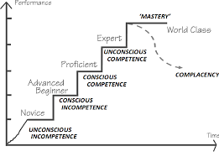
PERFORMANCE CREED LADDERS

